Slide 1


ACE SMP
By chris kopycinski

Slide 2
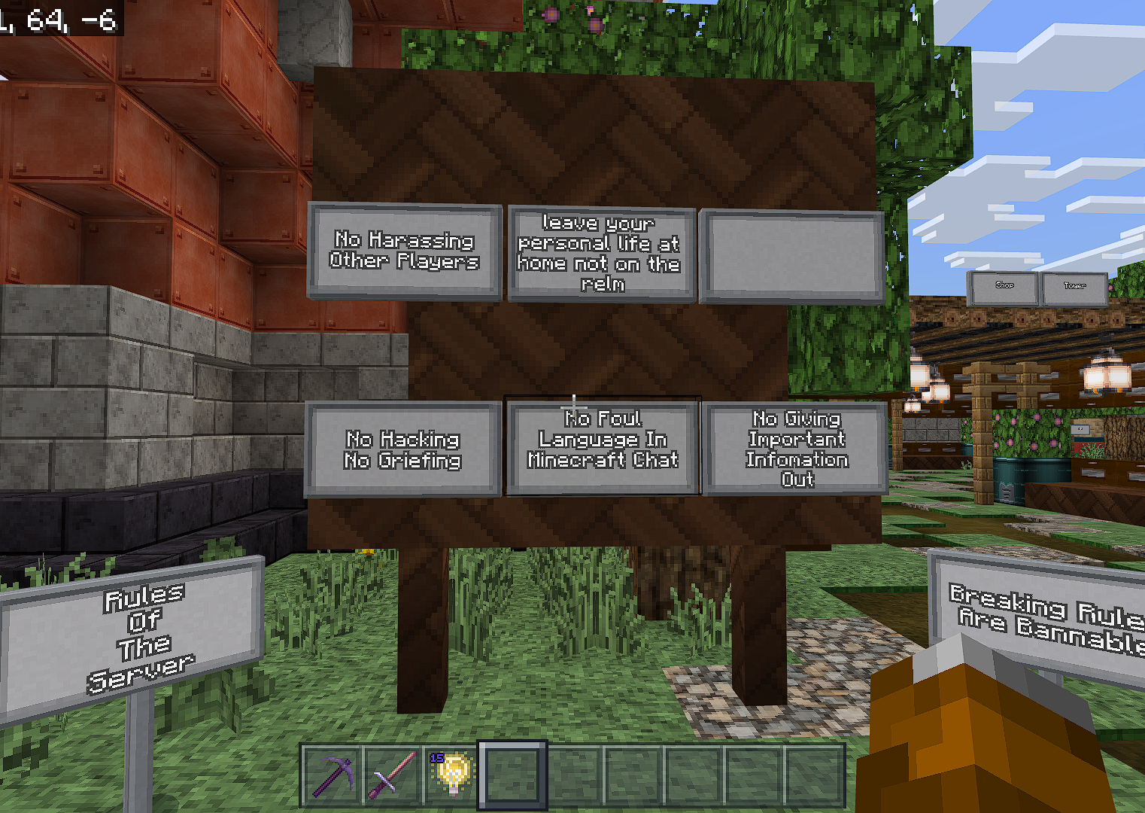
Rules of the server:
Welcome to ExpectedAces4862's Discord Server
Rule 1: This is a safe space. Do not organize, participate in, or encourage harassment of others. Homophobia, Transphobia, Racism, Xenophobia, and all Prejudices fall under this umbrella. They will all result in an immediate ban. Promoting the actions of a player/celebrity/famous person whose behavior would have violated any of the above rules is highly discouraged.
Rule 2: No swearing or trash talking. Rule
3: Hacking will not be tolerated at any time
Rule 4: No TikTok shorts are allowed
Rule 5: No NSFW content at all times, this server is mean't to be kid friendly
Rule 6: Refrain from pinging staff roles at all times constantly to draw attention except for extreme moderation requests.
Rule 7: Do not talk about people's personal information.
Rule 8: Do not spam at all times. Spamming is roughly defined as more than 10 messages every 5 seconds.
Rule 9: No bullying is allowed at all times.
Rule 10: Child predators are not welcome on this server
Rule 11: No begging for roles or staff roles
Rule 12: If your username is inappropriate we will kindly ask you to change it, if don’t you will be asked to change it and if you don’t you can be kicked. Punishments will be given by severity and at the discretion of the staff. You could be muted, kicked and/or banned depending on your actions.

Slide 3

Admins:
EXPE4CTEDACE4862
MEET THE KELLER
CHARLIE37604
BOSSYMIME
MINECAFTGAMER11

Slide 4
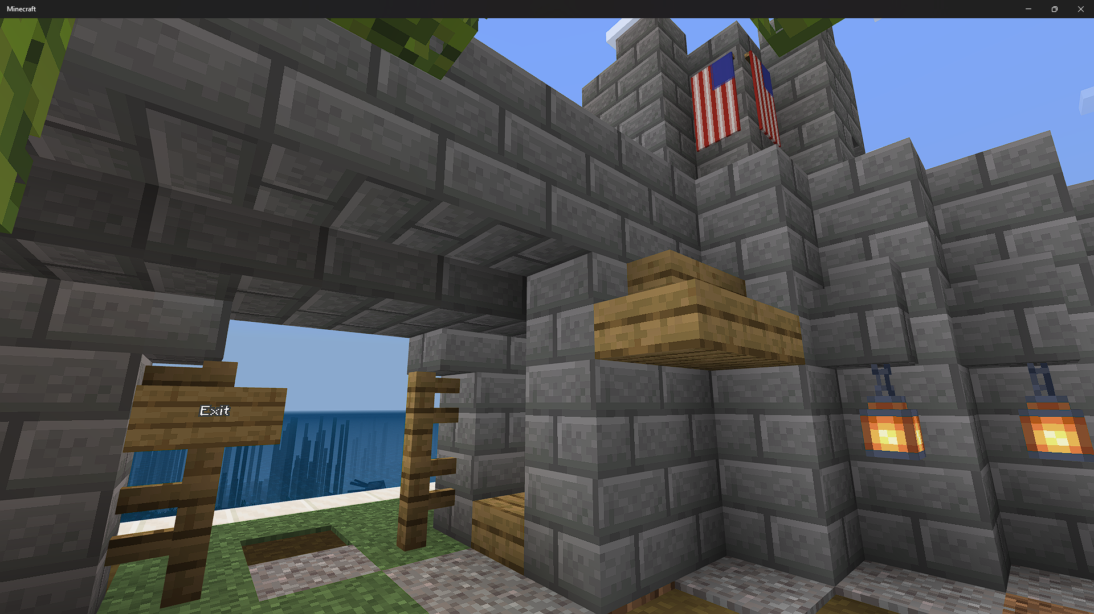

Slide 5
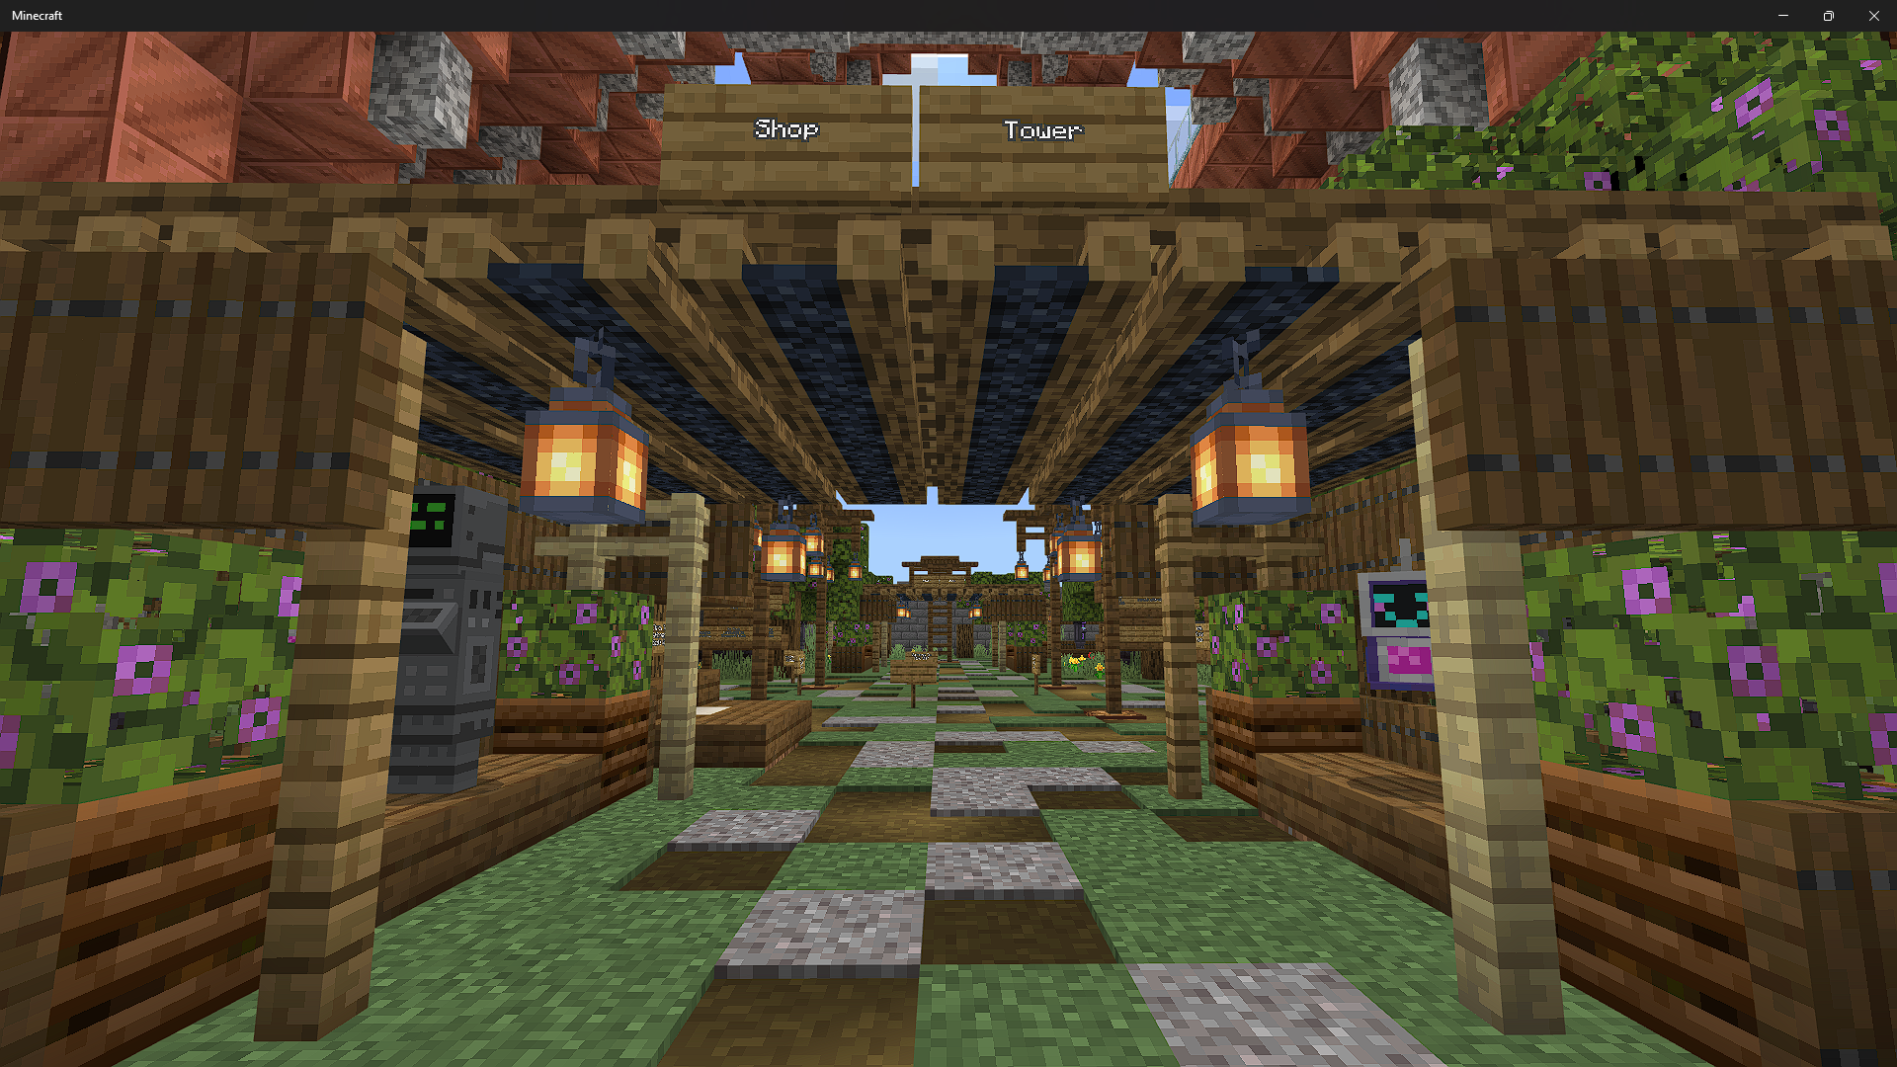

Slide 6
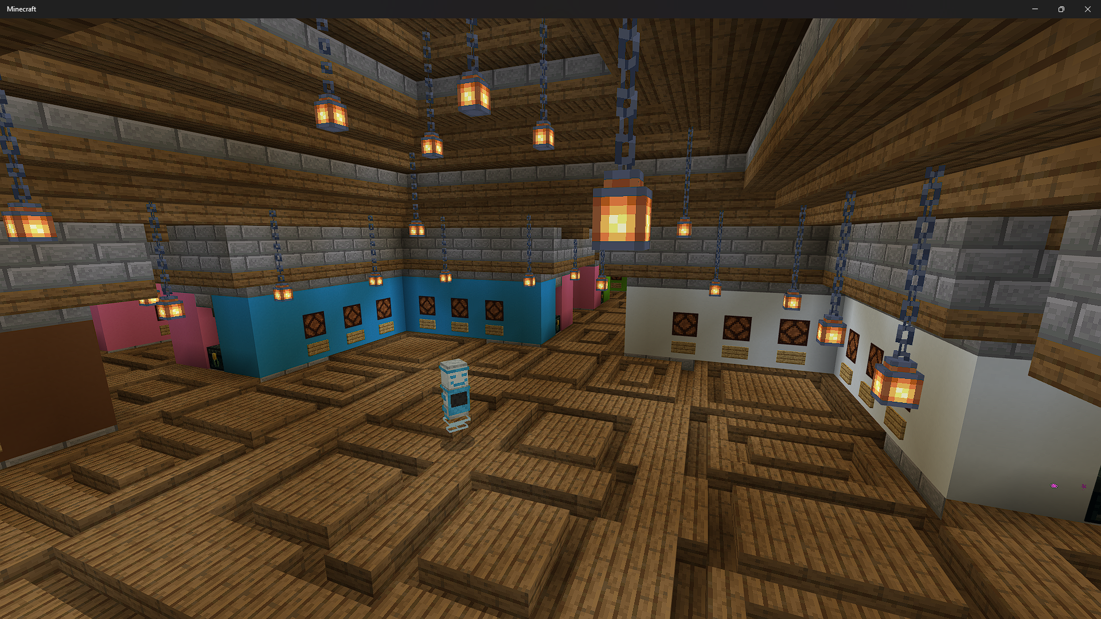

Slide 7
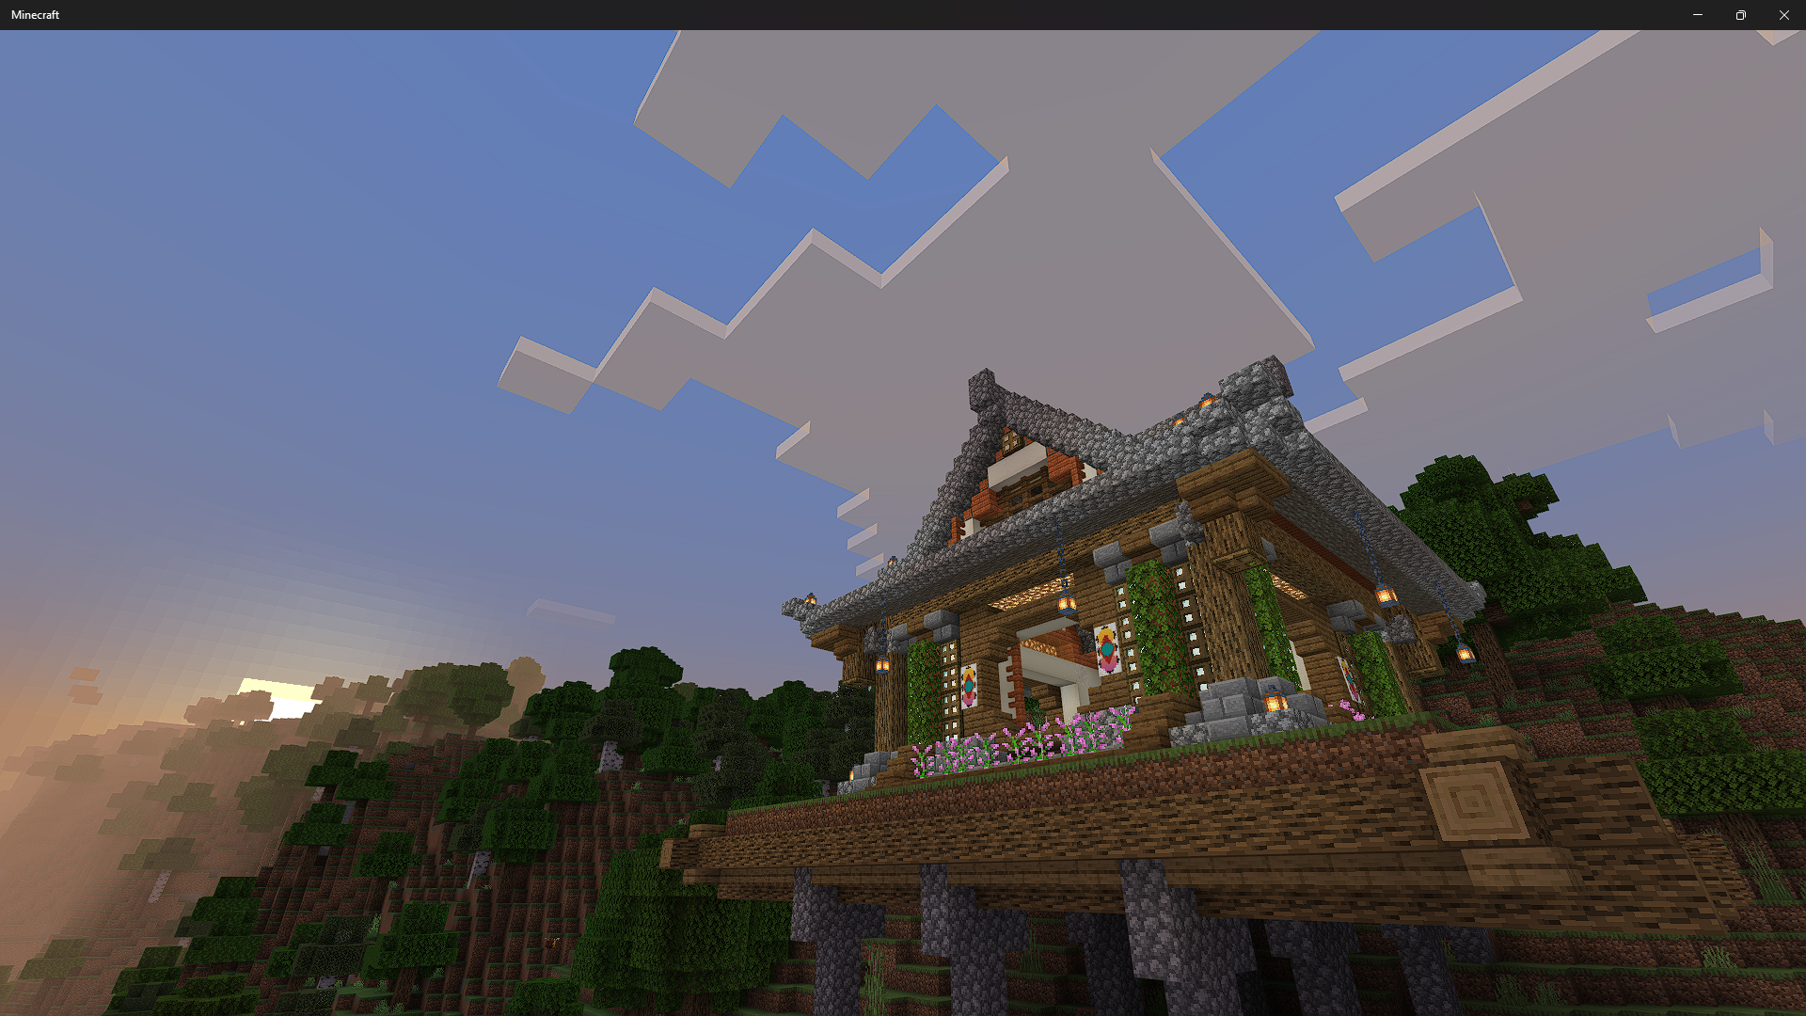

Slide 8
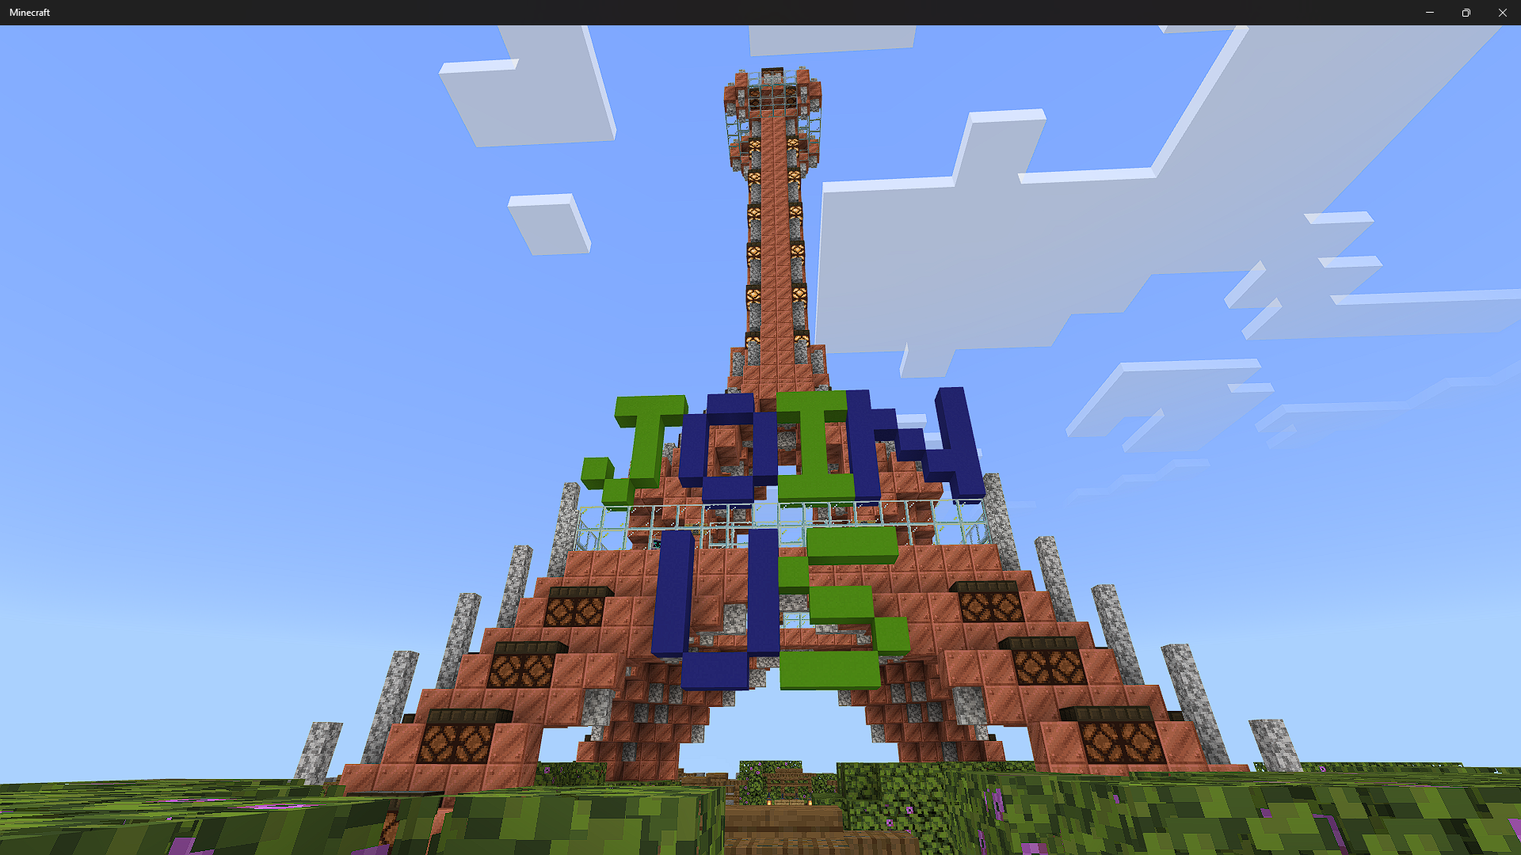
Hallo @everyone I officially made a official category called #VIP CHANNELS so if you want access to that category you have to boost the server or give the owner some real-life money thank you have a great day CO-FOUNDER BossyMime

Slide 9
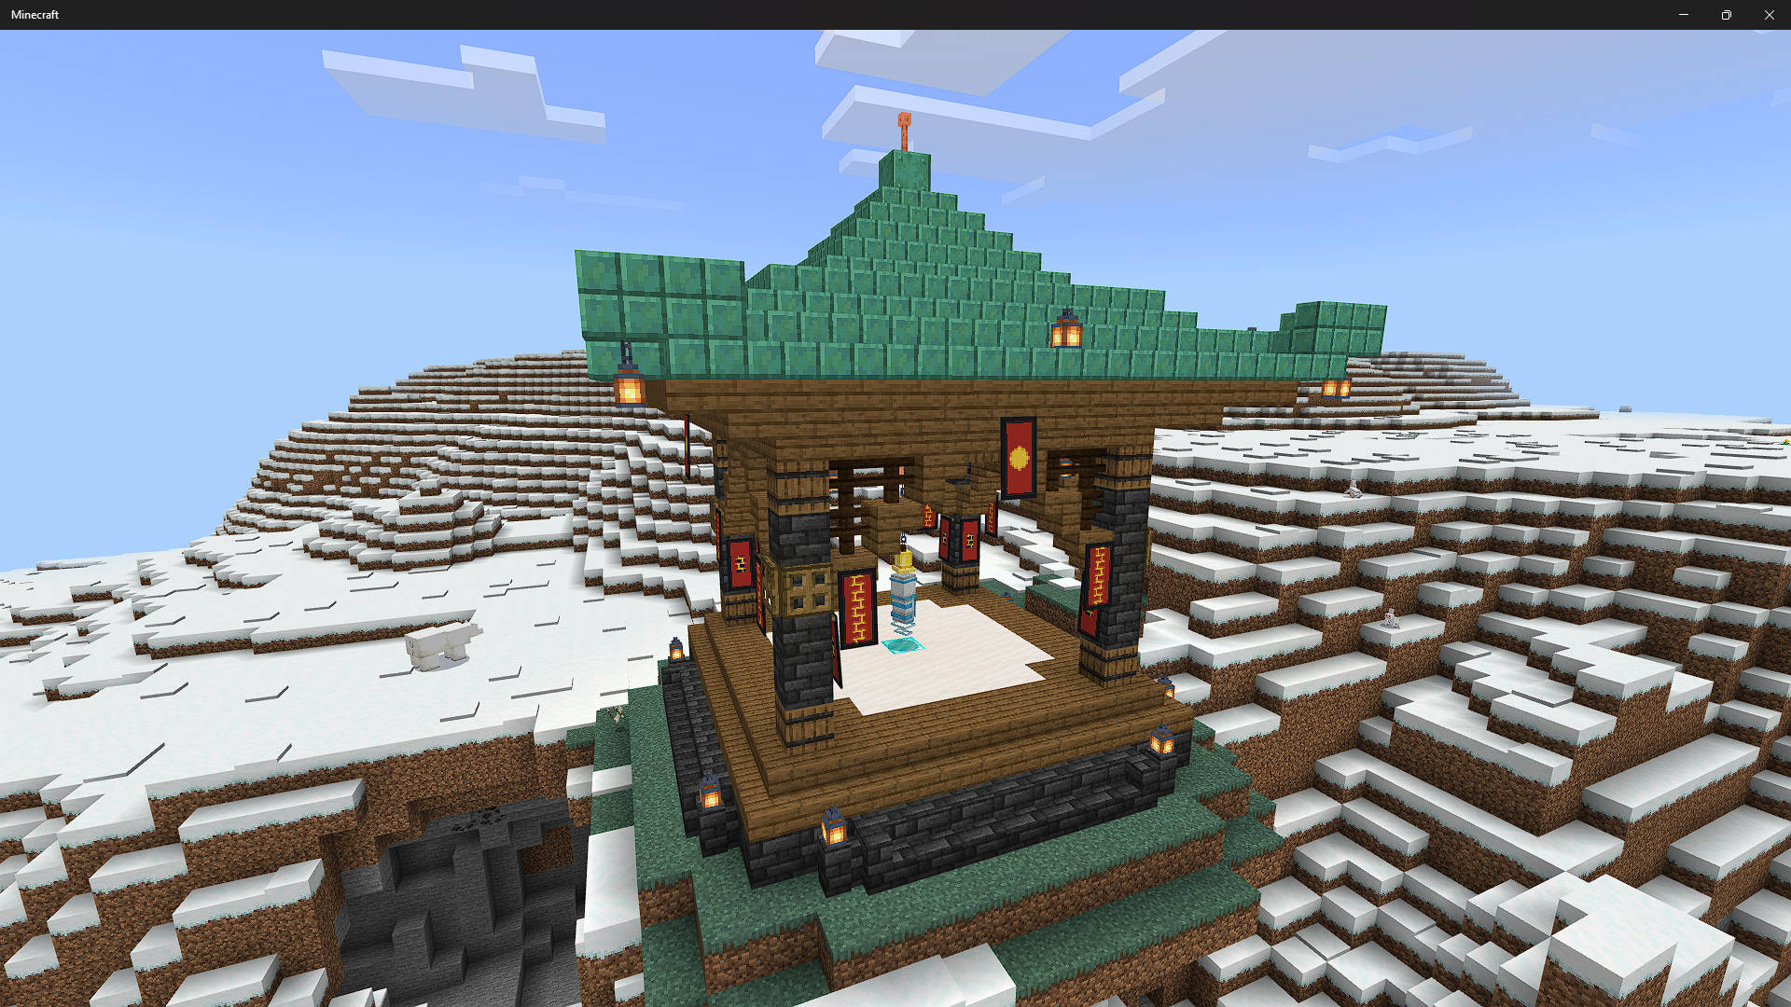
This is one of our teleporter's.

Slide 10

GOLDEN TICKET:
This tower. Is the golden ticket tower. Find the Golden Ticket And win a prize.

Slide 11
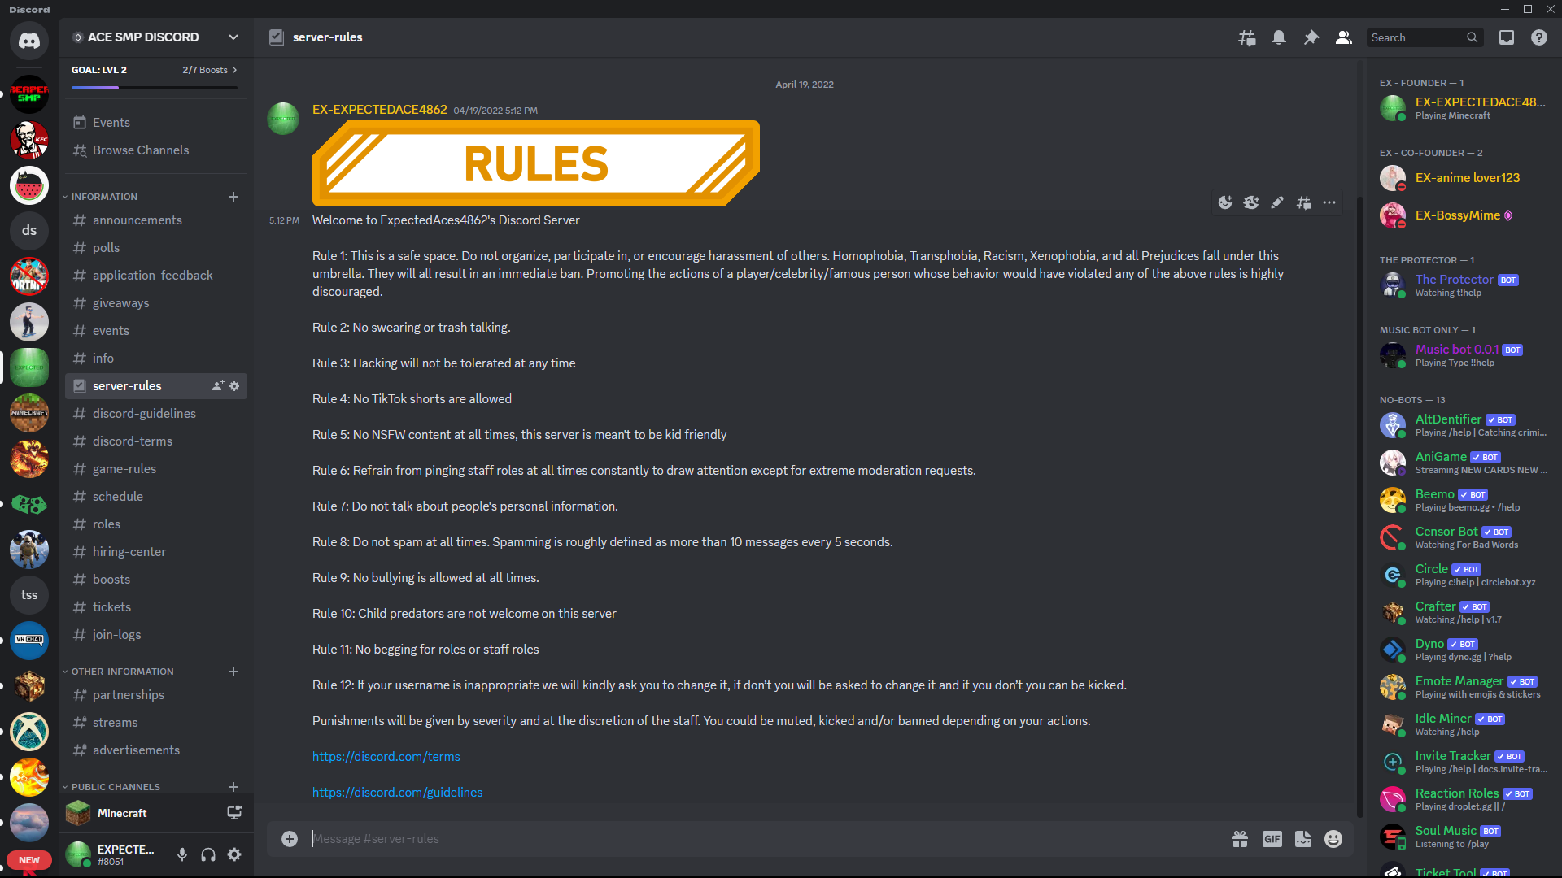
DISCORD INFO: BOSSYMIME THE CREATER OF OUR MUSIC BOT 0.0.1 MADE: FEB 18 2023.
https://discord.gg/kxmMWTXsXG

Slide 12

Credits:
FOUNDER: EXPE4CTEDACE4862
BILLDER: MEET THE KELLER.BILLED OF THE SERVER.
CODER: CHARLIE37604 DOSE THE CODEING FOR THE SERVER.
DISCORD: BOSSYMIME IS THE MANGER.
ADMIN: MINECAFTGAMER11

